Slide 1
Monthly Takeaways
Krishnaraj Thadesar
Associate Software Developer Intern
31st July 2024

Slide 2
Agenda
Introduction
Project Details
Description of Core Work
Software and Applications used
Challenges Faced
Takeaways and Learnings

Slide 3
About me and my Team
Me
My Team
Cruise RMS
Part of the Cruise RMS team.
Currently undergoing an Angular Training
I intend to also work in making the UI as soon as we finish training.
My team consists of Arun Pratap Singh, Harekishan Shivnani, Sunanda DuttaSen, Rajendra Mulgali and Omkar Chogale
My Mentor and manager is Mr. Harekishan Shivnani.
We are developing a new Product for IDeaS
It involves Forecasting revenue for Cruise Companies.

Slide 4
Cruise RMS
Backend
Database
Frontend
File Processing
Java Spring
Postgres Docker Containers
Relational
Angular
Design process ongoing in Figma

Slide 5



Core Work Ongoing
Demo Project
Processing Files
Designing Schema
Started with making a demo project to get a hands-on about our tech stack
Process Input files given by client.
Working with my team to design the schema, and learning in depth about it in the process.

Slide 6
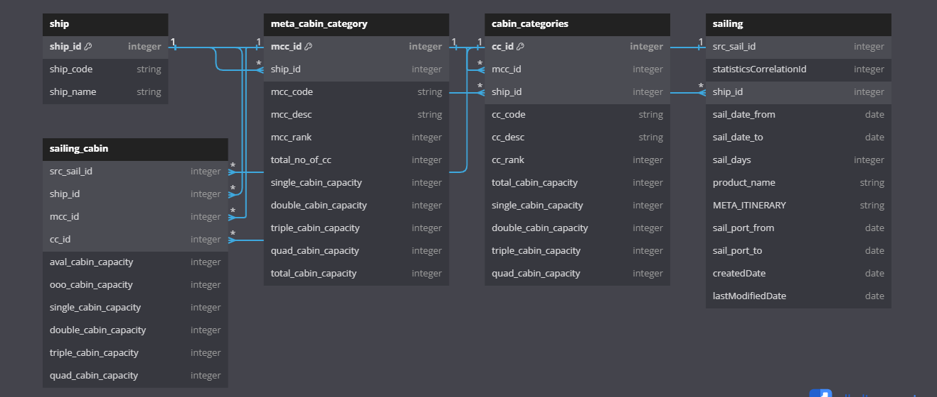
Currently Designed Schema for 2 Files
Work in progress (2 weeks)

Slide 7



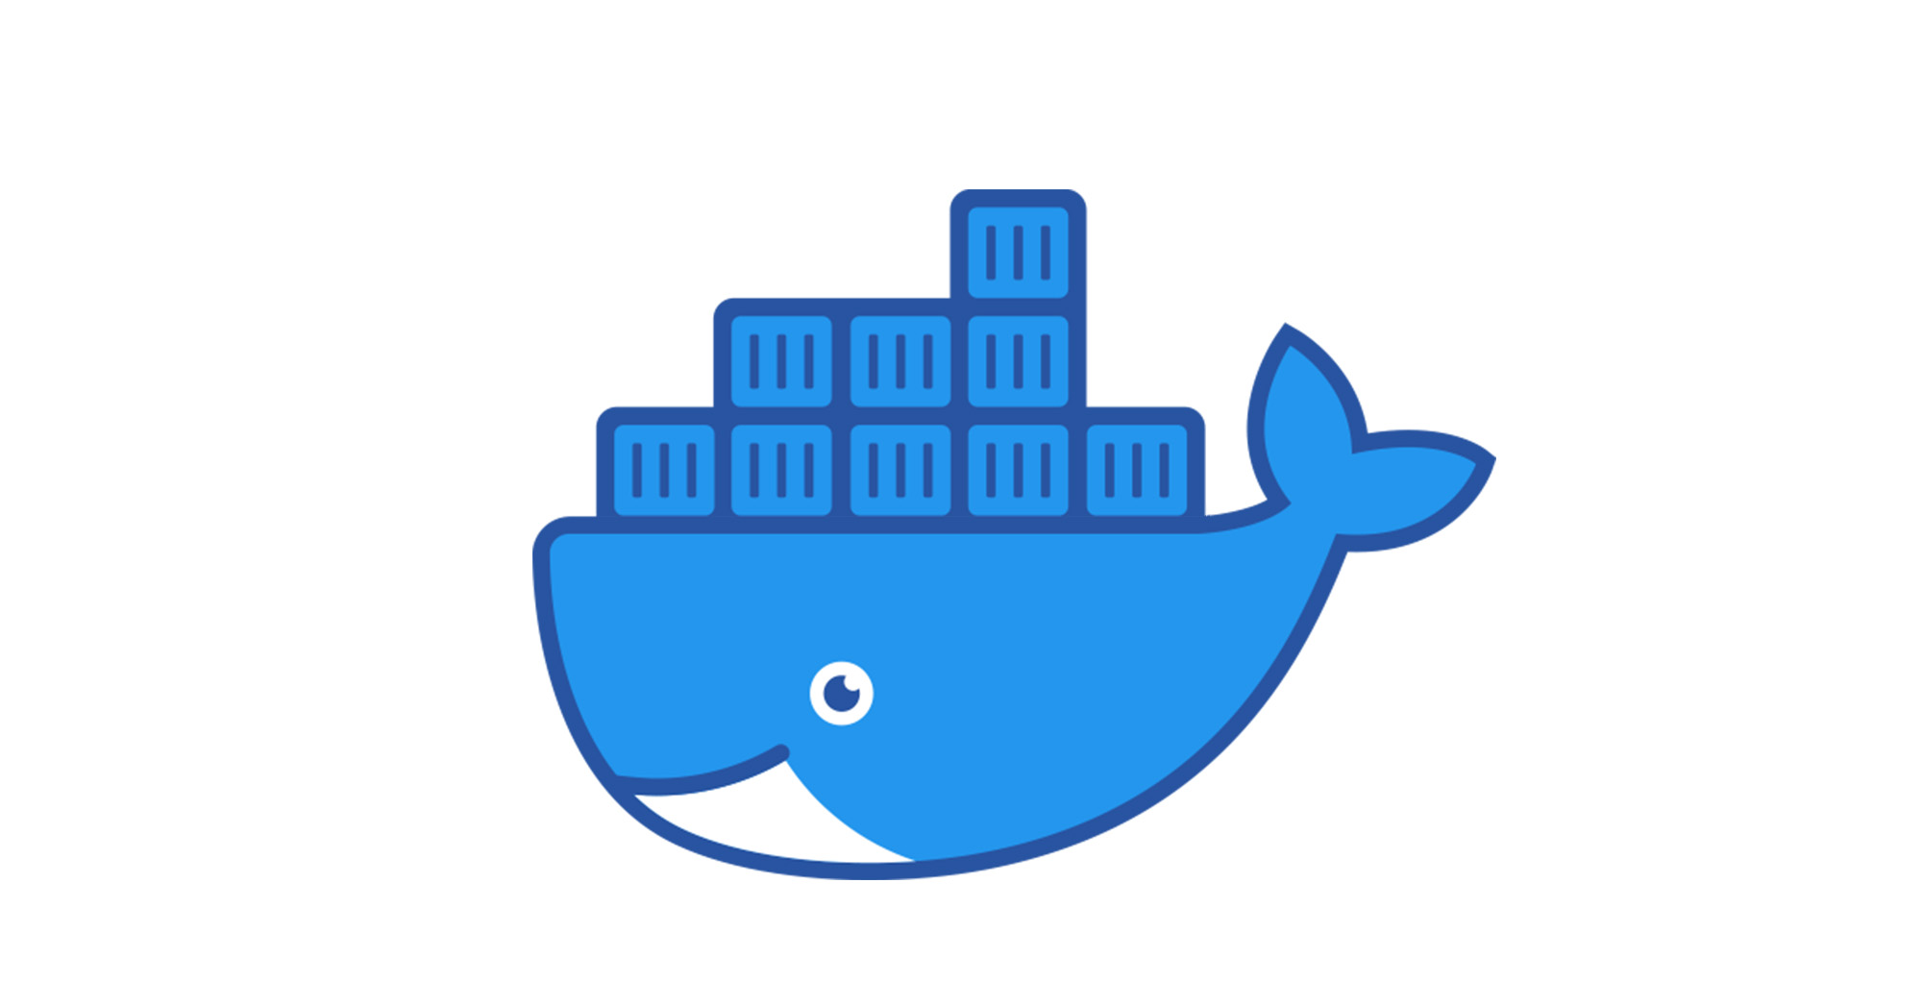


Software and Applications Used

Slide 8

✓
Database Errors and Normalization
✓
Test cases Failing
✓
Non Familiarity with Spring
Challenges Faced

Slide 9
Technical Learnings
Better code style and technique.
Farsightedness with regards to code, what it will go through, and how to make it robust.
It takes time to design, and its often worth spending that time in the beginning than to regret spending it later, and spend time fixing it instead.
Writing good code that doesn’t work is harder than writing bad code that works, and it is this that makes personal projects easier in comparison to enterprise applications, despite achieving the same result at small scale.

Slide 10
Personal Learnings
It is often better to focus on learning something well in the beginning rather than to focus on finishing something hastily.
It is in fact true that we don’t even know how much is unknown to us, and available to learn.
It is better to listen and observe, than to intervene and speak, unless prompted to.

Slide 11
Thank You
Heartfelt gratitude to Mr. Arun Pratap Singh and Mr. Harekishan Shivnani for taking the efforts to make sure I learn, and learn the right thing the right way.

